Slide 1
Bylaws Revisions 2023
Information and Feedback Sessions

Slide 2
Background

Slide 3
Why should we integrate UNMH and SRMC?
Expanded educational and research opportunities at SRMC.
Facilitate the movement of clinicians practicing at both locations.
Reduce the barriers to moving surgical cases, consults, and outpatients between UNMH and SRMC.
Reduced barriers to transferring inpatients between UNMH and SRMC.
Financial benefits:
SRMC is categorized as a "provider based campus" of UNMH which allows additional revenue generation at SRMC
Potential access to state appropriations as a UNMH site
Transparency of funds flow

Slide 4
Why Update the Bylaws?
As one hospital, we must have one medical staff and one set of bylaws on January 1st, 2024.
We are due for a routine bylaws update! (last one was in 2020)
Current bylaws are out of compliance with NM legal requirements regarding medical staff membership.
Bylaws will be updated every two years - it is an iterative process and we will continue to improve them!

Slide 5
Bylaws Taskforce Membership
UNMH: Steve McLaughlin, Jennifer Gibbs, Alisha Parada, Alex Rankin, Erik Kraai
UNMMG/SRMC: McKenzie Lake
SRMC: Matthew Wilks, Christopher Guest, Sara Assaf
SOM: Betty Chang, Joanna Fair
Service Chiefs: Christopher Arndt
Faculty: Jay Raval, Maria Montoya, Kathleen Reyes, Eva Angeli
UNM Legal: Jennifer James
MSS Staff: Alison Webster, Elizabeth Peters

Slide 6
Bylaws Revision Process
CCQS Consultant
SRMC Leadership
BYLAWS COMMITTEE
UNMH Leadership
SOM Leadership
Medical Staff representation

Slide 7
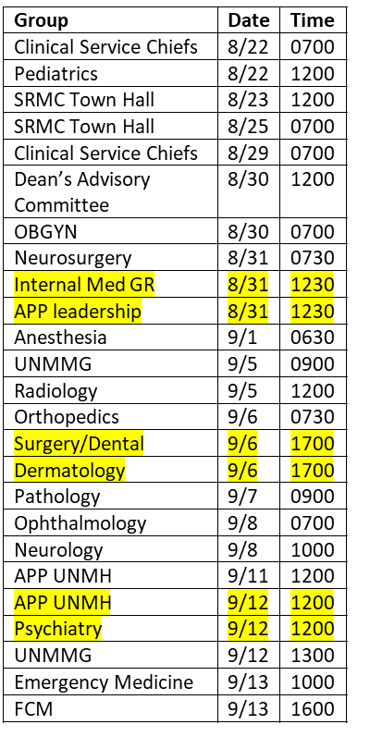
Timeline and Communication Plan
8/21-9/14 – Listening and Feedback Sessions
9/15 – Final draft bylaws to MEC
9/20 – MEC Vote
10/4 – Ballot posted for medical staff
10/17 – Completion of medical staff vote
10/20 – BOT Q+S
11/17 – BOT Vote
Concurrent with this process for the bylaws,
the revisions of rules + regulations will begin on 9/6
and will conclude with MEC vote on 11/15 and BOT on 11/17.

Slide 8
Current Medical Staff Membership
Number of unique providers within the UNM Health System = 1942
Approx 15% independent or on Professional Services Agreement
Number of UNMH Medical Staff + Privileged = 1629
Approx 11% independent or on Professional Services Agreement
Number of SRMC Medical Staff + Privileged = 654
Approx 23% independent or on Professional Services Agreement
Number of SRMC only providers, not already credentialed at UNMH = 147
Total SRMC community providers (independent, not on PSA) = 8
Numbers current as of 8/18/23

Slide 9
CMS Regulation of Provider Based Clinics - 42 CFR 413.65
Clinical services. The clinical services of the facility or organization seeking provider-based status and the main provider are integrated as evidenced by the following:
Professional staff of the facility or organization have clinical privileges at the main provider.
Implications –
Providers working at SRMC MUST have privileges at UNMH.
Contracted providers (PSA, Sole provider status) can have specific practice based on location or duties.

Slide 10
New Mexico Regulatory Background N.M. Code R. § 7.7.2
Currently out of compliance with medical staff membership requirements:
CAA, Clinician Pharmacists, Optometrists will become non-voting, privileged only providers.
UNM will work with appropriate professional organizations to change this at the State level.

Slide 11
Sandoval County Regulatory Background - Mill Levy
The Mill Levy Agreement with Sandoval County from which financial support is derived, has medical staff requirements:
SRMC must be open to all physicians who meet credentialing and privileging requirements.
Must allow non-employed providers to join medical staff.
Shall collaborate with other hospitals and physicians in the County to provider coverage across specialty shortage areas.

Slide 12
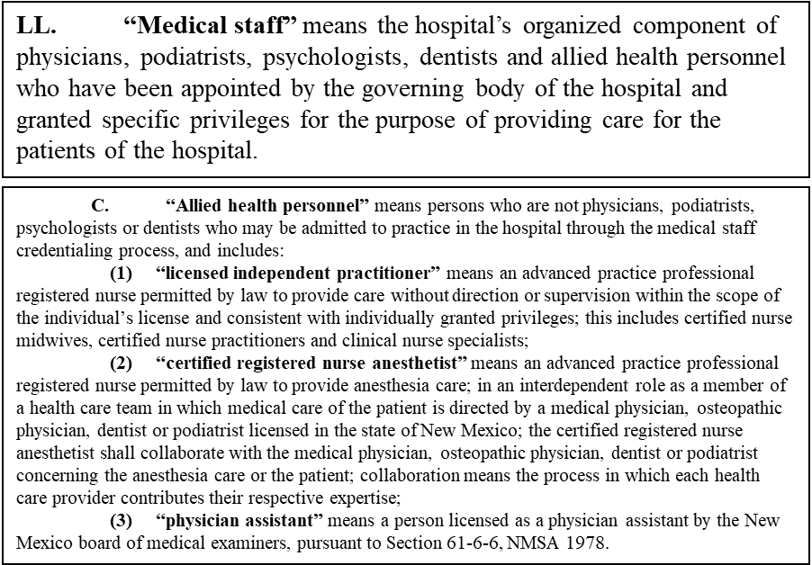
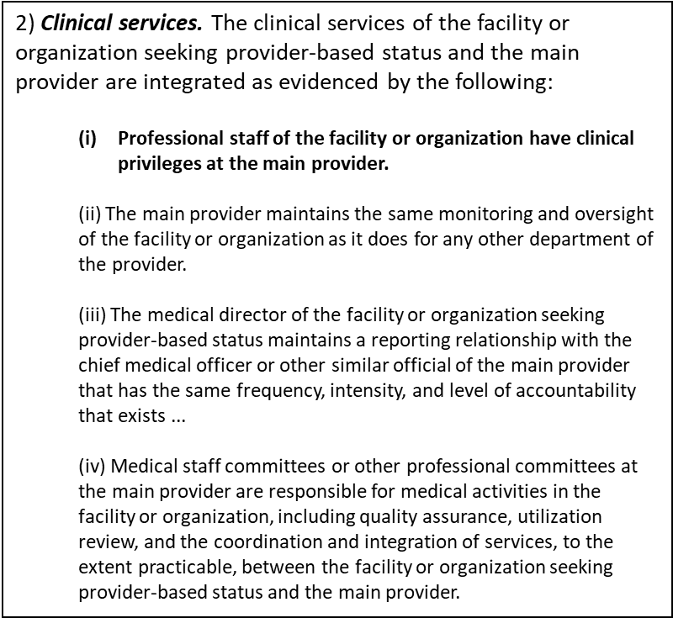
Exact Regulatory Language
N.M. Code R. § 7.7.2
42 CFR 413.65

Slide 13
Summary of Changes

Slide 14
Single Medical Staff
We will be a single institution after the merger with only one:
CEO and CMO
Chief of staff
Medical Executive Committee
May have a local Medical Staff Operating Council (MSOC) which deals solely with campus issues

Slide 15
Some Bylaws Are Not Changing!
Corrective action, fair hearing and appeal process are essentially unchanged.
Bylaws amendment and Rules & Regulations amendment processes are unchanged.
Many other areas without changes!

Slide 16
Consolidation of Membership Categories
Voting – on staff for at least one year and have > 24 days of patient contact per year, on average.
Can vote and hold office.
Nonvoting – on staff for less than one year or who do not qualify for Voting.
Cannot vote on medical staff ballots or hold office.
Can vote on committees on which they serve
Honorary (not a category, but a Recognition of service to the Institution)

Slide 17
Med Staff Membership
Option 2:
LAT from CSC if
UNMH, UNMMG, or UNM employment
PSA/Contract
Community
UNMH Medical Staff
(all locations)
Option 1:
SOM Faculty
appointment

Slide 18
LAT Qualification for Medical Staff
For non-SOM UNM faculty, UNMMG, UNMH, UNM, Providers under a PSA/contract and Community providers.
All current practitioners will be given a Letter of Academic Title (grandfather process).
LATs come from the Clinical Service Chief
A Memo of Expectation must accompany the LAT outlining the clinical, education, research, and administrative responsibilities of the provider

Slide 19
Membership on Medical Staff
Membership: includes physicians, dentists, podiatrists, clinical psychologists, and APPs (as defined by New Mexico law) can:
Vote on medical staff issues such as bylaws
Run for office
Hold privileges (the ability to take care of patients).
Privileged: (but not Medical Staff Members) can practice but not vote or run for office
Telemedicine practitioners,
Chiropractors, doctors of oriental medicine, pharmacist clinicians, optometrists, and certified anesthesiology assistants are not allowed membership per New Mexico law.

Slide 20
Credentialing Changes
A complete application must contain proof of faculty status at the UNM SOM or a Letter of Academic Title (LAT).
Expansion of the expedited credentialing process to not only appointment and reappointment, but to applications for additional privileges between reappointment cycles.
Telemedicine practitioners may now be credentialed by proxy.

Slide 21
Officer Transition
Transition period
The newly elected Vice Chief of Staff UNMH shall be elected to serve a one-year term (2024).
For 2024, the UNMH Chief of Staff shall continue to serve as the Chief of Staff.
For 2024, the UNMH Past Chief of Staff will continue to serve as Past Chief of Staff, and
For 2024 and 2025, the SRMC Past Chief of Staff will continue to serve as a Past Chief of Staff.

Slide 22
Clinical Service Chiefs
One Clinical Service for each service across both campuses, with one Clinical Service Chief.
The School of Medicine Department Chair will be the Clinical Service Chief.
If they are not qualified to be the Service Chief, the Dean in conjunction with the Chair may appoint a Clinical Service Chief.
The Clinical Service Chief may appoint a Clinical Service Vice Chief to serve, if needed.
The specifics for this will be in the Rules & Regulations.
Anesthesiology – C Arndt
Dental – N Boyd
Dermatology – A Smidt
Emergency Medicine – D Rimple
Family and Community Medicine – F Rohan-Minjares
Internal Medicine – M Unruh
Neurology – M Torbey
Neurosurgery – J Russell
OB/GYN – E Espey
Ophthalmology – J Chodash
Orthopaedics – G Treme
Pathology – N Joste
Pediatrics – L Cordova de Ortega
Psychiatry – M Tohen
Radiology – S Eberhart
Surgery – J Marek

Slide 23
MEC Membership Changes
Current Voting
Chief of Staff (Chair)
Vice Chief of Staff
Immediate Past Chief of Staff
SOM Dean
Senior Vice President for Clinical Affairs
UNMH CMO
Senior Associate Dean of Clinical Affairs
Chiefs of all Clinical Departments
Senior Associate Dean of GME
Cancer Center CMO
5 Members at Large (at least 1 APP)
Credentials Committee Chair
Professional Practice Committee Chair
Current Non-Voting
UNMH CEO, COO, CNO, Chief Ambulatory Officer, Chief Medical Quality Officer
Associate CMOs of Children's Hospital, Inpatient, Outpatient
Chief Medical Informatics Officer
Resident Physician
Proposed Voting
Chief of Staff (Chair)
Vice Chief of Staff
Immediate Past Chief of Staff
Senior Associate Dean for Clinical Affairs
Senior Associate Dean for GME
Cancer Center CMO
Chiefs of all Clinical Services
Three (3) At-Large members from UNMH (at least 1 must be an APP)
Three (3) At Large members from SRMC (at least 1 must be an APP)
Campus specific at-large members must spend at least twenty-five percent (25%) of their clinical time at that campus
Proposed Non-Voting
UNMH CEO, COO, CNO, Chief Medical Quality Officer
SOM Dean
Senior Vice President for Clinical Affairs
CMO of UNMH
CMO of SRMC
ACMO of Children's Hospital
Chairs of Credentials Committee, Professional Practice Committee
Chief Medical Informatics Officer
Resident Physician

Slide 24
Timeline and Next Steps
8/21-9/14 – Listening and Feedback Sessions
9/15 – Final draft bylaws to MEC
9/20 – MEC Vote
10/4 – Ballot posted for medical staff
10/17 – Completion of medical staff vote
10/20 – BOT Q+S
11/17 – BOT Vote

Slide 25
Voting Process
Voting members of the medical staff will receive an email with the ballot and supporting information.
The ballot will be open for voting for two weeks.
Voting will be for the entire set of changes (not each change individually.)
12.5% of medical staff must vote for the vote to be counted.

Slide 26
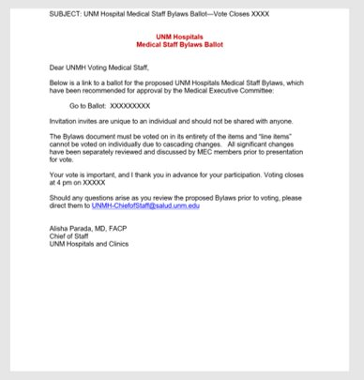
Example of Ballot and Supporting Material
Example email to Medical Staff with the link to the ballot and materials.

Slide 27
Information and Feedback Sessions
Group | Date | Time | Zoom/location | Med Staff Attendees
Clinical Service Chiefs | 8/22 | 0700 | https://hsc-unm.zoom.us/j/92856871426 Password: 525717 | McLaughlin, Chang
Pediatrics | 8/22 | 1200 | https://hsc-unm.zoom.us/j/93027655924 Passcode: 522603 | Mclaughlin, Chang
SRMC Town Hall | 8/23 | 1200 | Hybrid https://hsc-unm.zoom.us/j/92797104783?from=addon Passcode: 014450 | Wilks, McLaughlin, Elizabeth
SRMC Town Hall | 8/25 | 0700 | Hybrid https://hsc-unm.zoom.us/j/91680826825?from=addon Passcode: 455461 | Wilks, Chang, Elizabeth, Bertha
Clinical Service Chiefs | 8/29 | 0700 | https://hsc-unm.zoom.us/j/92856871426 Password: 525717 | McLaughlin, Chang
OBGYN | 8/30 | 0700 | https://hsc-unm.zoom.us/j/96797046886 Passcode: obgyn | McLaughlin, Chang, Alison
Dean’s Advisory Committee | 8/30 | 1200 | Pending | Chang, McLaughlin, Alison
Neurosurgery | 8/31 | 0730 | In person – 2 ACC | McLaughlin, Chang, Wilks
UNMMG | 8/31 | 1200 | https://hsc-unm.zoom.us/j/91209188657 Passcode: 216755 | Wilks, Bertha
Internal Med GR | 8/31 | 1230 | Zoom | Chang, Alison
APP leadership | 8/31 | 1230 | https://hsc-unm.zoom.us/s/99750696956 Passcode: 232163 | McLaughlin
Anesthesia | 9/1 | 0630 | In person - 2 ACC | Chang, Wilks, Alison
Radiology | 9/5 | 1200 | https://hsc-unm.zoom.us/j/96369147270 Passcode: 029694 | McLaughlin, Wilks, Alison
Orthopedics | 9/6 | 0730 | https://hsc-unm.zoom.us/j/95932826020 Password unmzortho | McLaughlin, Bertha
Surgery/Dental | 9/6 | 1700 | https://hsc-unm.zoom.us/j/94559100063 Passcode: 229671 | McLaughlin

Slide 28
Information and Feedback Sessions
Dermatology | 9/6 | 1700 | https://hsc-unm.zoom.us/j/93426720922 Passcode: 642067 | Chang, Bertha
Pathology | 9/7 | 0900 | https://hsc-unm.zoom.us/j/93376914761 | McLaughlin, Alison
Ophthalmology | 9/8 | 0700 | https://hsc-unm.zoom.us/j/99792867617 Passcode Ophth23 | McLaughlin
Neurology | 9/8 | 1000 | https://hsc-unm.zoom.us/j/91981736626 Passcode: 895365 | Wilks, Elizabeth
APP UNMH | 9/11 | 1200 | https://hsc-unm.zoom.us/j/91567748227 Passcode: 1212 | McLaughlin
UNMMG | 9/12 | 0700 | https://hsc-unm.zoom.us/j/95381307549 Passcode: 724434 | McLaughlin
APP UNMH | 9/12 | 1200 | https://hsc-unm.zoom.us/j/91567748227 Passcode: 1212 | McLaughlin
Psychiatry | 9/12 | 1200 | https://hsc-unm.zoom.us/j/97257453382 Passcode:2223 | Chang
Emergency Medicine | 9/13 | 1000 | In person – IDTC 1620 | McLaughlin, Wilks
FCM | 9/13 | 1600 | https://hsc-unm.zoom.us/j/93557495281?from=addon#success Passcode: DFCM | McLaughlin, Chang

Slide 29
Questions

